Slide 1

Agora de la Gestion Financière sur les modèles factoriels obligataires
3 juillet 2018

Slide 2

Intervenants :
Anthony Desrousseaux et Raul Leote de Carvalho, BNP Paribas AM
Jean-Charles Bertrand, directeur des investissements multi-actifs d’HSBC Global Asset Management, et professeur affilié à HEC
Jean-François Boulier, Président du Comité de Pilotage des Agoras de la Gestion de l'AFG et Président de l’Af2i

Slide 3

Factor-based strategies in credit
Anthony Desrousseaux et Raul Leote de Carvalho,
BNP Paribas AM

Slide 4
Factor-based Strategies in CREDIT
BNPPAM – MAQS Quant Fixed Income
July 2018
Olivier Laplenie - BNPPAM
MARKETING COMMUNICATION
March 2018
FOR PROFESSIONAL INVESTORS

Slide 5


Biographies of the speaker
Anthony Desrousseaux: Quant Fixed Income Portfolio Manager
13 years with BNP Paribas Asset Management
5 years in Portfolio Management
Previously Credit Structurer in New-York then Paris
Graduated from Telecom SudParis (1997), Chartered Financial Analyst (2008)
BNPPAM – Multi Asset Quant & Solutions - Key figures
13 professionals (8 Portfolio Managers) dedicated to quantitative solutions across all asset classes *
Supported by a transversal Quant Research team (27 professionals) for quantitative research *
Managing 10bn EUR of asset in quantitative strategies, of which over 3.1bn EUR in Fixed Income *
Provider of factor-based solutions in equities since 2008 and in fixed income since 2009
* Source: BNP Paribas AM, as of end of 2017

Slide 6
FACTORS in fixed income : why and how?
1
P2のご留意事項をご確認ください。

Slide 7
Understanding drivers of risk and return
Breaking down asset risks and returns
Examples
BETA
Directional market risk
Traditional beta
In equities: beta to market cap indices
In fixed income: duration and credit risk
In equities: traditional indices (MSCI World, S&P500, STOXX Europe 600)
In fixed Income: Sovereign, Investment Grade & High Yield, short/long duration indices
ALPHA
Factor premia
Factor exposure
Explicit factor investment
Indirect exposure to factors
Value / Carry
Low Risk
Quality / Fundamentals
Momentum
Size
Unexplained returns
Other alpha
Manager skill (non-systematic)
Market timing
Discretionary stock/bond picking (not style-based)
Source: BNP Paribas AM, for illustrative purpose only

Slide 8
Our investment philosophy
Capturing pure alpha from risk-controlled factors
A fully systematic approach with a human supervision
Efficient on large investment universes
A disciplined and transparent investment process
The portfolio manager is key from strategy design to portfolio execution
A pure factor-based approach building on in-house research:
Focusing on the specific drivers of each market segment
Aiming to separate directional risks from factor alpha
Risk oriented, to:
Have precise control over the risk allocated to each sub-strategy
Avoid taking unwanted tracking error
Allow full customization to match the constraints of investors

Slide 9
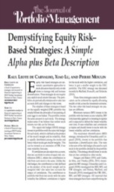
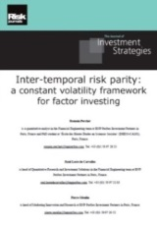
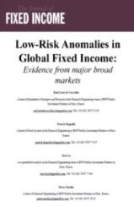
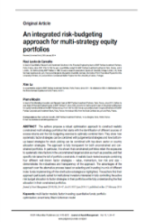
The main research findings underpinning our approach
Demystifying Equity Risk-Based Strategies: A Simple Alpha Plus Beta Description – September 2011
Main findings: We considered five risk-based strategies: equally-weighted, equal-risk budget, equal-risk contribution, minimum variance and maximum diversification. All five can be well described by exposure to the market-cap index and to four simple factors: low-beta, small-cap, low-residual volatility and value.
Investors should focus on factor-based strategies
Inter-Temporal Risk Parity: A Constant Volatility Framework for Factor Investing – November 2014
Main findings: An inter-temporal risk parity strategy re-balances the portfolio to the level of leverage required to target a constant ex-ante risk over time. The benefits of the inter-temporal risk parity strategy are more important for equity and foreign-exchange factors, with the strongest volatility clustering and fat tails.
Risk parity across factors (= risk budgeting approach) provides improved risk-adjusted returns
Low-Risk Anomalies in Global Fixed Income: Evidence from Major Broad Markets – September 2013
Main findings: In this paper we present the most compelling empirical evidence yet of a low-risk anomaly in fixed income markets. We show that portfolios invested in bonds with the lowest risk would have delivered the largest positive alpha and highest Sharpe ratios and portfolios invested in riskier bonds would have delivered the most negative alpha and lowest Sharpe ratios.
The Low-risk factor can be extended to fixed income
Diversify and Purify Factor Premiums in Equity Markets – January 2017
Main findings: We consider a number of portfolio construction approaches designed to capture factor premiums with the appropriate levels of risk controls aiming at increasing information ratios. We show that information ratios can be increased by targeting constant volatility over time, hedging market beta and hedging exposures to the size factor, i.e. neutralizing biases in the market capitalization of stocks used in factor strategies.
“Purifying” factors improves risk-adjusted returns

Slide 10




Fixed income factors overview
Fixed Income factor themes/style
Carry (value)
Fundamentals
Momentum
Low risk
Looking for attractive risk-adjusted carry
Based on non-price related data (balance sheet, macro…)
Focusing on market dynamics and sentiment
Targeting securities with the best return-to-risk
Government bonds
Forex
Corporate bonds
Source: BNP Paribas AM, as of end of December 2017. For illustrative purposes only
Notes:
We began research on quant and factor-based strategies in 2005, starting with global govies, expanding in 2007 to FX and finally credit in 2013
We have identified four main factors driving relative returns in the fixed income world
However, each type of fixed income risk (rates, FX, credit) requires specific indicators to be captured robustly and efficiently
We are one of the few managers able to offer a complete set of multi-factor models covering gov, FX, and credit

Slide 11
MULTI-factor credit: SELECTING FACTORS
2

Slide 12
Factor selection
Key characteristics required before selecting a factor
Explanatory power:
We favor factors that are key drivers of fixed income markets, in particular with a strong academic backing and an economic/market rationale
Sustained performance:
The premium associated to the factor needs to be persistent through time
Absence of bias:
There should be a balanced contribution from all components to the performance of the factor
(i.e. no structural over/under-weight to a specific country/currency that explains the performance)
Ability to exploit the factor:
You have to be able to efficiently capture the factor premium, which requires a reasonable turnover level and to be based on reliable data
Complementarity:
We favor factors that are uncorrelated with other factor premiums, both on average and in the tail of the distributions (i.e. with drawdowns that do not occur simultaneously)

Slide 13
Testing Factors
How do we find and test factors ?
Ideas
  Ratios used by credit analyst, agencies:
Leverage ratios, coverage ratios ?
  Ratios used by equity factor models:
  Equity price momentums, equity volatility ?
  Ratios linked to bonds markets ?
Collecting Data
  Coverage for a full credit benchmark (thousands of bonds/issuers)
  How to map a bond to an equity ?
  Systematic mapping, manual mapping
Back testing from 2000

Slide 14
Scoring a Factor
From the bond to the score
Mapping
Bond
Obligor
Data
Collection
Bond To Score
for one Factor
Financial Reports
Market Data
Normalization
Factor Score
Factor Value

Slide 15
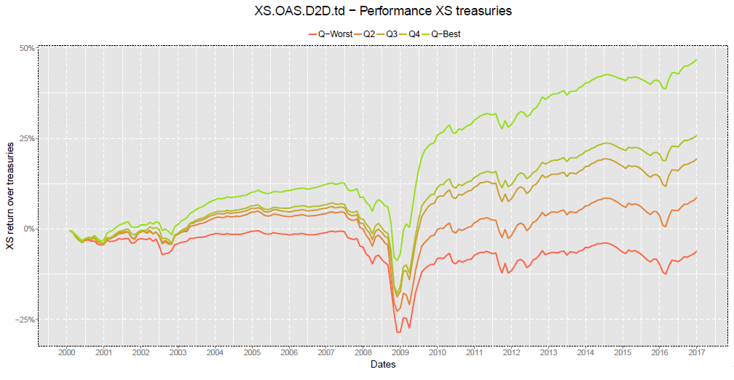
Illustrative example: cumulated performance per quintile
General idea: focusing on bonds that have an attractive valuation in regards to their risk
Main indicator(s): OAS* / distance to default
Performance per quintile on a USD IG universe: OAS to distance to default
* OAS: Option-adjusted spread
Source for the chart: BNP Paribas AM, as of December 2017. The simulations are the result of estimates of BNP Paribas AM based on various parameters used and should not be viewed as a promise of future results of the fund. As a consequence, data contained herein are indicative only and are provided solely for information purposes. Past performance or achievements are not indicative of current or future performance.

Slide 16
Systematic scoring of corporate bonds
A unique blend of fixed income, equity and fundamental factors
Factor scoring:
Bond are scored on each factor between -2 and +2
Investment Universe: Euro Inv. Grade, USD Inv. Grade, USD High Yield bonds
Scorings are sector-neutral in order to avoid structural biases
A proprietary approach is used to rank bonds to a pool of bonds with similar risk (duration, maturity)
Style / Theme | Factors
Value | 25% | Spread / Distance to Default
 |  | Equity book-to-price
Quality | 25% | EBITDA*/Debt
 |  | Financing Cash / Debt
Momentum | 25% | Equity 12M/1M
 |  | Asset Growth 5Y
Low Risk | 25% | Debt to Market Cap
 |  | Distance to Default
For illustrative purposes only.
*EBITDA : earnings before interest, tax, depreciation and amortization
This is for illustrative purposes only and should not be used as a basis for making any specific investment, business or commercial decisions

Slide 17
Example: score skyline of a bond selected by the model
Example 1: attractive value and quality, with below average risk
Score skyline of bond 1
Value
Quality
Momentum
Low risk
Source for the chart : BNPPAM as of end of February 2018
This is for general information only and should not be used as a basis for making any specific investment, business or commercial decisions.
Any economic and market trend, prediction, projection or forecast is not necessarily indicative of the future or likely performance of the funds.
Overview :
  Value: Good - the bond under consideration exhibits an attractive spread-to-risk ratio
  Quality: Good - Schneider ranks better than its sector peers regarding its dependence on financing flows
  Momentum: Neutral - both the equity price momentum and the asset growth are roughly neutral
  Low risk: Good - its financial leverage is good relative to its sector peers

Slide 18
Example: score skyline of a bond not selected by the model
Example 2: good value but poor quality, momentum and risk
Score skyline of bond 2
Value
Quality
Momentum
Low risk
Source for the chart : BNPPAM as of end of February 2018
This is for general information only and should not be used as a basis for making any specific investment, business or commercial decisions.
Any economic and market trend, prediction, projection or forecast is not necessarily indicative of the future or likely performance of the funds.
Overview :
  Value: Good - the bond under consideration exhibits a high spread relative to its risk
  Quality: Poor – both quality factors score poorly relative to the sector
  Momentum: Poor – the equity price momentum suggest negative sentiment
  Low risk: Poor - its financial leverage looks high compared to sector peers

Slide 19
Factor statistics (pro-forma, USD Investment Grade)
Alpha based on excess returns vs Treasuries - Information Ratio by Quintile
 | Q.Worst | Q2 | Q3 | Q4 | Q.Best
FCF/Debt | -0.59 | -0.24 | -0.05 | 0.15 | 0.60
FinancingCash/Debt | -0.29 | -0.76 | -0.24 | 0.85 | 0.47
OAS/Distance to default | -1.75 | -1.24 | 0.13 | 0.93 | 1.59
Book/Price | -1.68 | -0.35 | 0.29 | 0.87 | 1.29
Equity Momentum 12M/1M | -1.58 | -0.71 | 0.50 | 1.22 | 1.41
Asset Growth 5Y | -0.26 | -0.69 | 0.27 | 0.62 | 0.26
Distance to default | -1.55 | -0.99 | 0.20 | 0.93 | 1.50
Debt/Assets | -0.72 | -0.69 | 0.18 | 0.58 | 1.03
Source for the table and chart: BNP Paribas AM, as of December 2017
The simulations are the result of estimates of BNP Paribas AM based on various parameters used and should not be viewed as a promise of future results of the fund. As a consequence, data contained herein are indicative only and are provided solely for information purposes. Past performance or achievements are not indicative of current or future performance.

Slide 20
PORTFOLIO CONSTRUCTION AND
Performance simulations
4

Slide 21

Portfolio construction and execution
From factors to portfolio
Building a portfolio while controlling risks relative to the benchmark
  Weight caps per bond and issuer for a well-diversified portfolio (minimum 100-150 bonds)
  Robust optimization aiming to keep the average duration and spread close to benchmark
  Integration of customized constraints if applicable, notably ESG
  Use of derivatives to align the risk of portfolio (volatility) with the benchmark
Ensuring smooth execution
  Monthly rebalancing at the start of each month
  Average one-way turnover of about 6-7% per month arising from strong research efforts
  New bonds enter the portfolio only if their expected alpha is significantly higher than transaction costs
  Order execution within preset limits of bid/offer

Slide 22
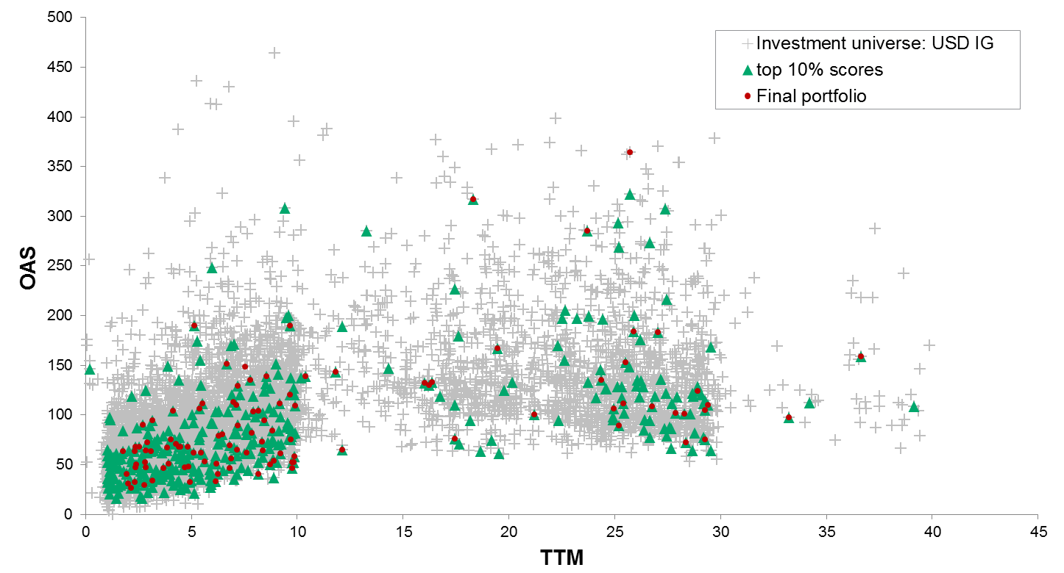
Overview of the selected bonds
Scatter plot of the portfolio relative to the investment universe (USD Inv. Grade)
Source for the chart: BNP Paribas AM, as of December 2017
The simulations are the result of estimates of BNP Paribas AM based on various parameters used and should not be viewed as a promise of future results of the fund. As a consequence, data contained herein are indicative only and are provided solely for information purposes. Past performance or achievements are not indicative of current or future performance.
22

Slide 23
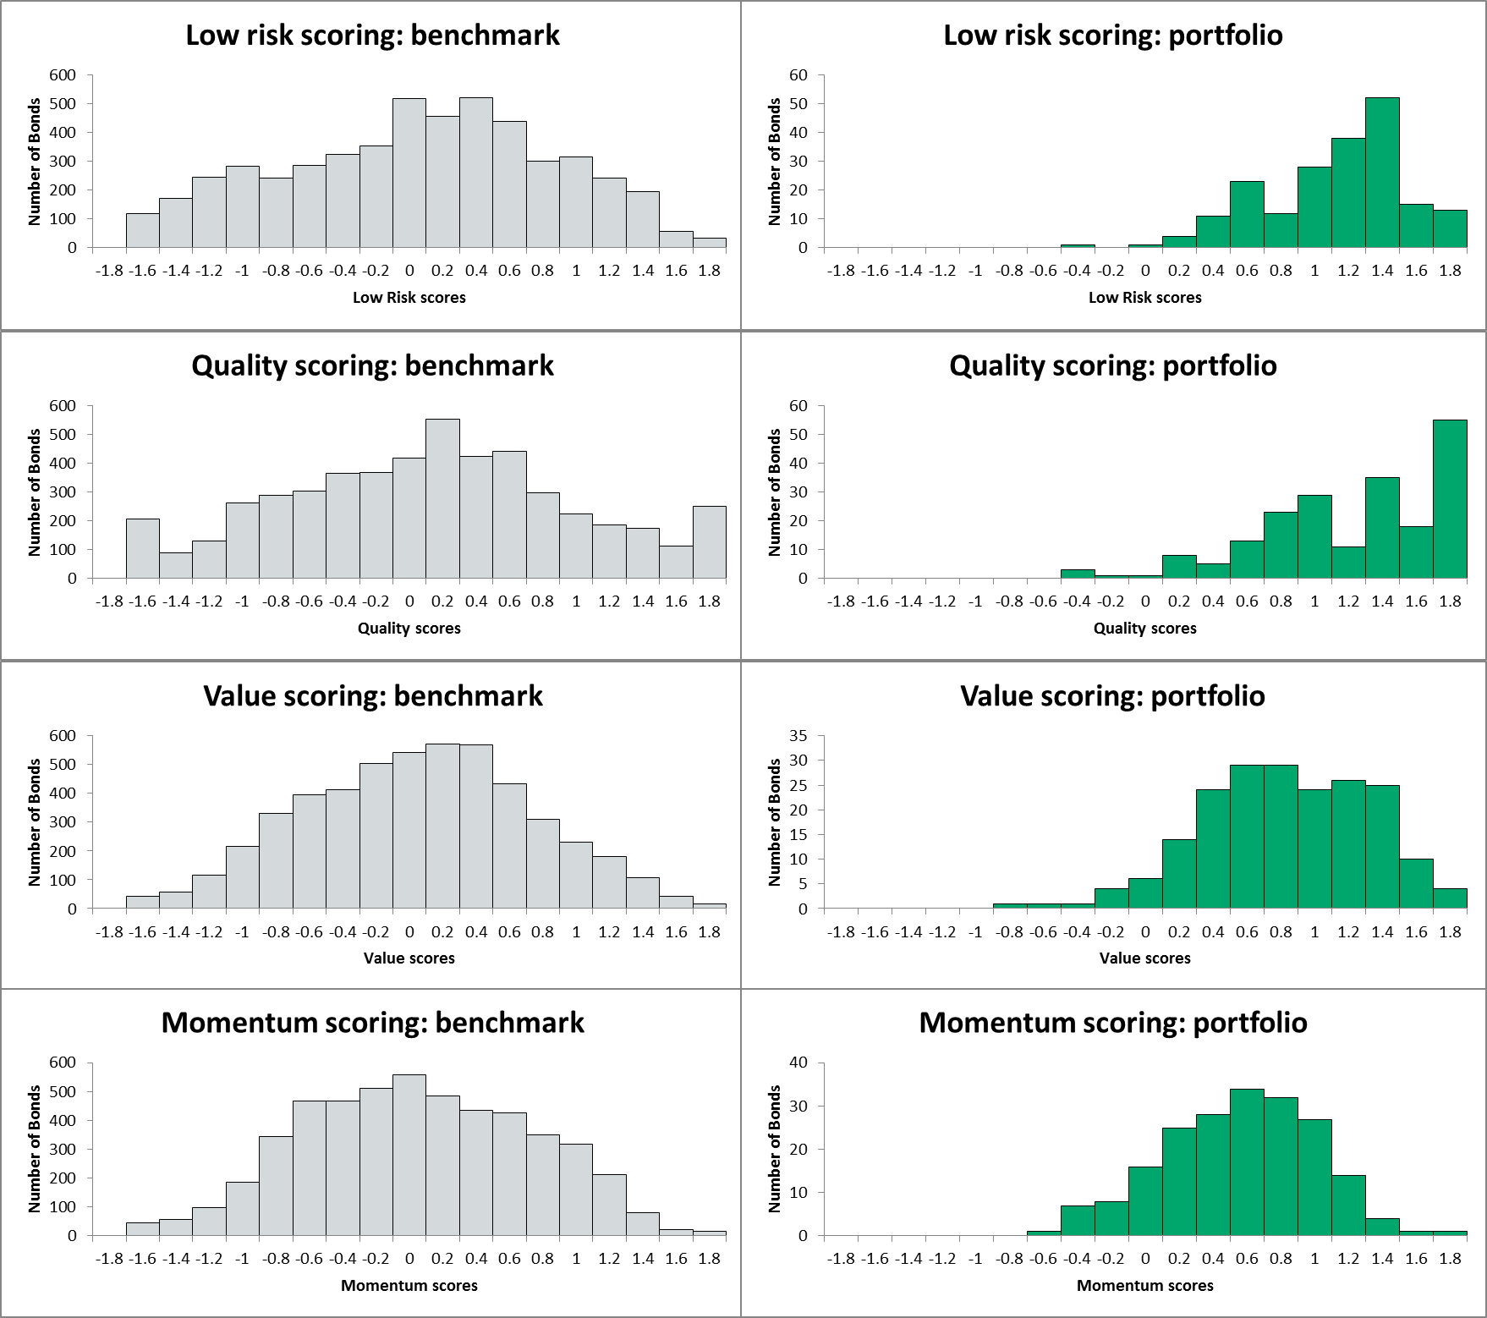
Average factor scoring of the portfolio (USD + EUR IG)
Source for the charts and tables: BNPPAM as of end of March 2018. The simulations are the result of estimates of BNP Paribas AM based on various parameters used and should not be viewed as a promise of future results of the fund. As a consequence, data contained herein are indicative only and are provided solely for information purposes. Past performance or achievements are not indicative of current or future performance.
Past performance or achievement is not indicative of current or future performance

Slide 24
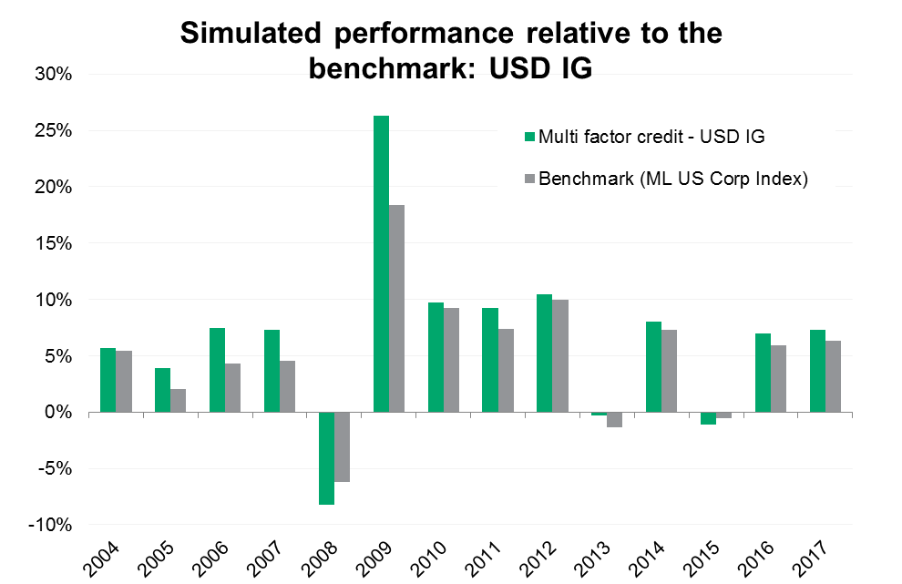
Performance (pro-forma simulation): USD IG
Net of estimated transaction costs, gross of fees
Source for the chart and tables: BNPPAM , Bloomberg, BoAML, as of end of December 2017 Hypothetical or simulated performance results are presented for illustrative purposes only and have many inherent limitations. Such results do not reflect actual portfolio returns or fees and are generally prepared with the benefit of hindsight. No representation is made that any portfolio will or is likely to achieve profits or losses similar to those shown. Please see Additional Disclosures for further information.

Slide 25
Main risks associated to the strategy
Interest rates risk: The risk category is justified by the investment mainly in Interest Rate instruments. The investor's attention is drawn to the fact that an increase in interest rates results in a decrease in the value of investments in bonds and debt instruments and more generally fixed income instruments.
Credit Risk: This risk relates to the ability of an issuer to honour its commitments: downgrades of an issue or issuer rating may lead to a drop in the value of associated bonds.
Liquidity Risk: This risk arises from the difficulty of selling an asset at a fair market price and at a desired time due to lack of buyers.
Counterparty Risk: This risk is associated with the ability of a counterparty in an Over The Counter financial transaction to fulfil its commitments like payment, delivery and reimbursement.
Derivatives Risk: When investing in over the counter or listed derivatives, the Fund aims to hedge and/or to leverage the yield of its position. The attention of the investor is drawn to the fact that leverage increases the volatility of the subfund.

Slide 26
Disclaimer
BNP PARIBAS ASSET MANAGEMENT France, “the investment management company,” is a simplified joint stock company with its registered office at 1 boulevard Haussmann 75009 Paris, France, RCS Paris 319 378 832, registered with the “Autorité des marchés financiers” under number GP 96002.
This material is issued and has been prepared by the investment management company.
This material is produced for information purposes only and does not constitute:
1. an offer to buy nor a solicitation to sell, nor shall it form the basis of or be relied upon in connection with any contract or commitment whatsoever or
2. investment advice.
This material makes reference to certain financial instruments authorised and regulated in their jurisdiction(s) of incorporation.
No action has been taken which would permit the public offering of the financial instrument(s) in any other jurisdiction, except as indicated in the most recent prospectus and the Key Investor Information Document (KIID) of the relevant financial instrument(s) where such action would be required, in particular, in the United States, to US persons (as such term is defined in Regulation S of the United States Securities Act of 1933). Prior to any subscription in a country in which such financial instrument(s) is/are registered, investors should verify any legal constraints or restrictions there may be in connection with the subscription, purchase, possession or sale of the financial instrument(s).
Investors considering subscribing to the financial instrument(s) should read carefully the most recent prospectus and Key Investor Information Document (KIID) and consult the financial instrument(s’) most recent financial reports. These documents are available on the website.
Opinions included in this material constitute the judgement of the investment management company at the time specified and may be subject to change without notice. The investment management company is not obliged to update or alter the information or opinions contained within this material. Investors should consult their own legal and tax advisors in respect of legal, accounting, domicile and tax advice prior to investing in the financial instrument(s) in order to make an independent determination of the suitability and consequences of an investment therein, if permitted. Please note that different types of investments, if contained within this material, involve varying degrees of risk and there can be no assurance that any specific investment may either be suitable, appropriate or profitable for an investor’s investment portfolio.
Given the economic and market risks, there can be no assurance that the financial instrument(s) will achieve its/their investment objectives. Returns may be affected by, amongst other things, investment strategies or objectives of the financial instrument(s) and material market and economic conditions, including interest rates, market terms and general market conditions. The different strategies applied to financial instruments may have a significant effect on the results presented in this material. Past performance is not a guide to future performance and the value of the investments in financial instrument(s) may go down as well as up. Investors may not get back the amount they originally invested.
The performance data, as applicable, reflected in this material, do not take into account the commissions, costs incurred on the issue and redemption and taxes.
All information referred to in the present document is available on www.bnpparibas-am.com

Slide 27

Factor-based investing : un développement contrasté
Jean-Charles Bertrand,
directeur des investissements multi-actifs d’HSBC Global Asset Management, professeur affilié à HEC

Slide 28
Factor-based investing : un développement contrasté
Succès pour les actions individuelles : plus de 300 papiers académiques et 200 facteurs déjà en 2014 (Harvey, Liu et Zhu)
Extension progressive aux autres classes d’actifs
  Asness, Moskowitz et Pedersen, « Value and Momentum everywhere » , 2013
  Koijen, Moskowitz, Pedersen et Vrugt, « Carry », 2013
Une approche encore limitée sur le crédit :
  Robeco (2014), AQR (2017 et 2018) BNP (2014 et 2018)

Slide 29
Factor-based investing : stratégies factorielles ou quantitatives actives ? (1)
Facteurs | Définitions
Value | Spread vs Fitted spread – Spread / Distance to Default
Carry | OAS
Momentum | Excess return to Treasuries – Equity return
Low Risk | Leverage-Gross Profitability-Low Duration – DTS – DTY – Debt to Market cap
Size | Public debt size
Defensive / Quality | Ebitda / Debt – Financing Cash / debt

Slide 30
Factor-based investing : stratégies factorielles ou quantitatives actives ? (2)
Les définitions des facteurs Value et Low Risk / Defensive / Quality n’apparaissent pas évidentes :
  Le facteur Value ressemble plus à une stratégie quantitative active qu’à un facteur de « style »
  Ambiguité des facteurs Low Risk et Defensive / Quality
  Redondance avec les facteurs actions

Slide 31
Backtests : réalité ou illusion ?
Un constat : les coûts de transaction par unité de risque sont beaucoup plus importants que sur les marchés actions
Peu de transparence sur les hypothèses de coûts de transaction
Prise en compte de coûts de transaction variables en fonction de l’environnement ?
Les sources de prix standard (BVAL pour Barclays/Bloomberg , ICE pour BofA ML) ne reflètent pas toujours les conditions de marché
Possibilité de traiter ?
  Période de crise
  L’indice Iboxx Euro Liquid Corporate Bond comporte 40 titres
  Univers limité de CDS pour les positions short

Slide 32
Des explications convaincantes ?
Au-delà des backtests, il est primordial de trouver des explications aux primes liées aux facteurs :
  Primes de risque
  Anomalies / Explications Comportementales / Contraintes / Limits to Arbitrage
Besoin de mieux comprendre la nature des primes factorielles sur les marchés de crédit
« Who is on the other side ? »
  Seul le portefeuille de marché cap-weighted est macro-consistent: tous les investisseurs peuvent détenir le même portefeuille à l’équilibre
  Les stratégies factorielles ne sont pas macro-consistent
  Mieux comprendre pourquoi les primes ne sont pas arbitrées

Slide 33
Intervenants :
Anthony Desrousseaux et Raul Leote de Carvalho, BNP Paribas AM
Jean-Charles Bertrand, directeur des investissements multi-actifs d’HSBC Global Asset Management, et professeur affilié à HEC
Jean-François Boulier, Président du Comité de Pilotage des Agoras de la Gestion de l'AFG et Président de l’Af2i

Slide 34
Agora de la Gestion Financière sur les modèles factoriels obligataires
3 juillet 2018

